Slide 1
Fundamentals of Corporate Finance
by
Robert Parrino, Ph.D. & David S. Kidwell, Ph.D.

Slide 2
CHAPTER 9
Stock Valuation

Slide 3
Types of Equity Securities
Quick Links
The Market for Stocks
Equity Valuation

Slide 4
The Market for Stocks
Basic Facts
Equity securities are a corporation’s certificates of ownership.
Households dominate holdings of equity securities, owning >36% of outstanding corporate equities.
Pension funds are largest institutional investors in equities (21%), followed by mutual funds (20%), and foreign investors (10%).

Slide 5
The Market for Stocks
Secondary Markets
Outstanding shares of a stock are bought and sold among investors.
From investor’s perspective, secondary markets provide marketability at a fair price for shares of securities they own.
Active secondary market enables firms to sell their new debt or equity issues at lower funding costs than can firms without secondary markets that sell similar securities.

Slide 6
The Market for Stocks
The Efficiency of Secondary Markets
In US, most secondary market transactions are done on one of the stock exchanges.
In terms of total volume of activity and total capitalization of firms listed, NYSE is the world’s largest and NASDAQ is the second largest.
In terms of number of companies listed and shares traded daily, NASDAQ is larger than NYSE.

Slide 7
The Market for Stocks
The Efficiency of Secondary Markets
There are four types of secondary markets.
Each differs according to amount of price information available to investors, which in turn, affects market’s efficiency.

Slide 8
The Market for Stocks
The Efficiency of Secondary Markets - Direct Search
Secondary markets farthest from our ideal of complete price information are those in which buyer and seller must seek each other out directly.
A thorough search among all possible partners is seldom done to locate the best price.

Slide 9
The Market for Stocks
The Efficiency of Secondary Markets - Direct Search
Securities that sell in direct search markets are usually bought and sold infrequently.
  Thus no third party (broker or dealer) has incentive to serve the market.
Good examples of direct search markets:
  Sales of small private companies’ common stock and private placement transactions.
Direct search is the least efficient type of secondary market.

Slide 10
The Market for Stocks
The Efficiency of Secondary Markets - Brokered
Brokers bring buyers and sellers together to earn a fee, called a commission.
Brokers’ extensive contacts provide a pool of price information that individual investors could not economically duplicate themselves.
By charging a commission less than cost of direct search, they give investors incentives to utilize information by hiring them as brokers.

Slide 11
The Market for Stocks
The Efficiency of Secondary Markets - Dealer
Market efficiency is improved if someone in marketplace can provide continuous bidding (selling or buying) for the security.
Dealers provide this service by holding inventories of securities, which they own, then buying and selling from inventory to earn profit.

Slide 12
The Market for Stocks
The Efficiency of Secondary Markets - Dealer
Advantage of dealer over brokered market is that brokers cannot guarantee an order will be executed promptly.
  Dealers can offer guarantee, because they have inventory of securities.
A dealer market eliminates need for time-consuming search for fair deal by buying and selling immediately from dealers’ inventory of securities.

Slide 13
The Market for Stocks
The Efficiency of Secondary Markets - Dealer
NASDAQ is best-known example of dealer market.
Electronic communications network (ECN) systems provide additional price information to investors.
  Increase marketability and competition, which should improve NASDAQ efficiency.

Slide 14
The Market for Stocks
The Efficiency of Secondary Markets - Auction
In an auction market, buyers and sellers confront each other directly and bargain over price.
NYSE is best-known example of auction market.
In NYSE, auction for a security takes place at a specific location on the floor of the exchange, called a post.

Slide 15
The Market for Stocks
The Efficiency of Secondary Markets - Auction
The auctioneer is the specialist designated by exchange and allowed to act as dealer to represent orders placed by public customers.
NYSE is the most efficient equity market in US.

Slide 16
The Market for Stocks
Reading the Stock Market Listings
The Wall Street Journal, The New York Times, and other newspapers in large metropolitan areas provide stock listings for major stock exchanges, such as NYSE and relevant regional exchanges.
Exhibit 9.1 shows a section of NYSE listing in the Wall Street Journal.

Slide 17
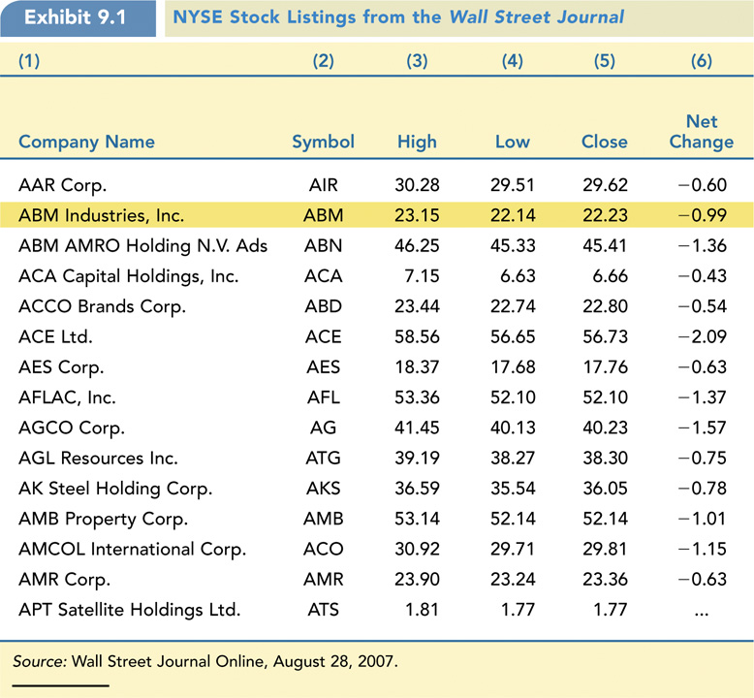
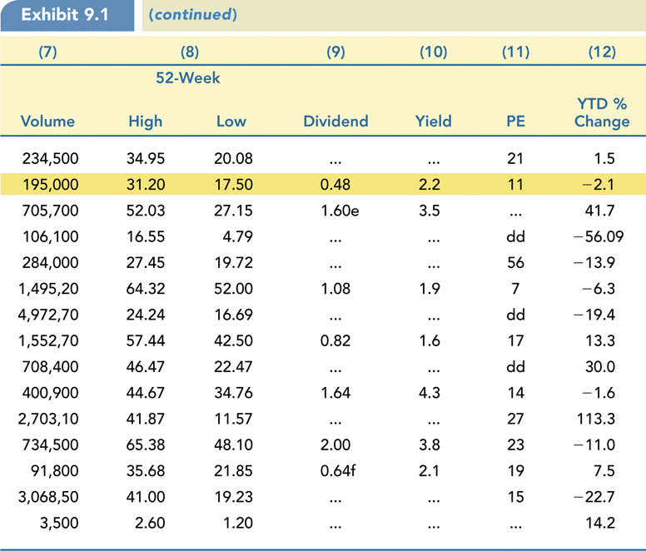
Exhibit 9.1: NYSE Stock Listings from WSJ

Slide 18
Types of Equity Securities
Common Stock and Preferred Stock
Two types of equity securities
  1) Common stock
  2) Preferred stock
Common stock represents basic ownership claim in a corporation.
One of the owners’ rights is to vote on all important matters that affect life of company, such as vote to elect board of directors, capital budget, or proposed merger or acquisition.

Slide 19
Types of Equity Securities
Common Stock and Preferred Stock
Owners of common stock are not guaranteed any dividend payments; have lowest priority claim on firm’s assets in event of bankruptcy.
Legally, common stockholders enjoy limited liability.

Slide 20
Types of Equity Securities
Common Stock and Preferred Stock
Preferred stock also represents ownership interest in corporation, but gets preferential treatment over common stock in certain matters.
Preferred dividend payments are firm’s fixed obligations, similar to interest payments on corporate bonds.
Dividend payments are paid with after-tax dollars subject to taxation.

Slide 21
Types of Equity Securities
Common Stock and Preferred Stock
Preferred stock owners are given priority over common stock owners with respect to dividends payments and claims against firm’s assets in event of bankruptcy or liquidation.
Even though preferred stock is equity, owners have no voting privileges.
Preferred stocks are generally viewed as perpetuities because they have no maturity.

Slide 22
Types of Equity Securities
Preferred Stock: Debt or Equity?
  Legally, preferred stock is equity.
  Like dividends on common stock, preferred-stock dividends are taxable.
  A strong case can be made that preferred stock is really a special type of bond.
    1) Regular preferred stock confers no voting powers.

Slide 23
Types of Equity Securities
Preferred Stock: Debt or Equity?
    2) Preferred stockholders receive fixed dividend regardless of firm’s earnings; if firm is liquidated, they receive a stated value (usually par)–not residual value.
    3) Preferred stocks often have “credit” ratings similar to those issued to bonds.
    4) Preferred stock is sometimes convertible into common stock.

Slide 24
Types of Equity Securities
Preferred Stock: Debt or Equity?
  5) Most preferred stock issues today are not true perpetuities.
Increasingly, preferred-stock issues have the sinking fund feature, which requires mandatory annual retirement schedules.
Valuation of common and preferred stock is done by using same basic methodology discussed for bond valuations in Chapter 6.

Slide 25
Types of Equity Securities
Preferred Stock: Debt or Equity?
Applying valuation procedure to common stocks is more difficult than applying it to bonds for various reasons.
  1) In contrast to coupon payments on bonds, size and timing of dividend cash flows are less certain.
  2) Common stocks are true perpetuities in that they have no final maturity date.

Slide 26
Types of Equity Securities
Preferred Stock: Debt or Equity?
Applying valuation procedure to common stocks is more difficult than applying it to bonds for various reasons.
  3) Unlike rate of return, or yield, on bonds, rate of return on common stock cannot be observed directly.

Slide 27
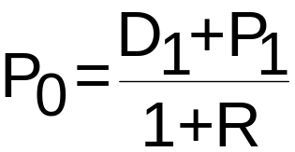
Equity Valuation
A One-Period Model
This provides estimate of market price.
Value of an asset is present value of its future cash flows–the future dividend and the end-of-period stock price.

Slide 28
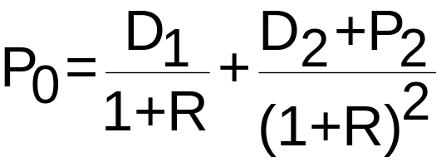
Equity Valuation
A Two-Period Model
This can be viewed as two one-period models strung together.

Slide 29
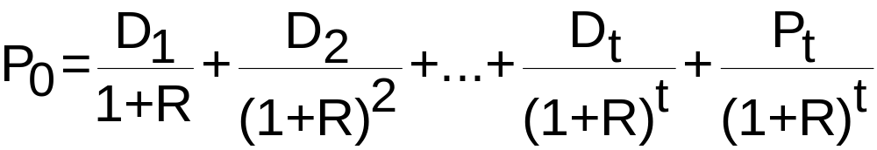
Equity Valuation
A Perpetuity Model
Comprised of a series of one-period stock pricing models strung together.
Although theoretically sound, this model is not practical to apply.
    The number of dividends could be infinite.

Slide 30
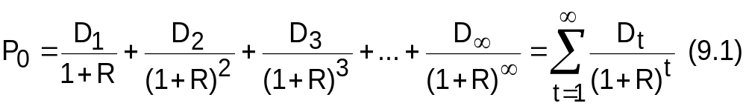
Equity Valuation
The General Dividend Valuation Model
Equation 9.1 is a general expression for the value of a share of stock.
  Price of a share of stock is the present value of all expected future dividends.
Formula does not assume any specific pattern for future cash dividends, such as a constant growth rate.

Slide 31
Equity Valuation
The General Dividend Valuation Model
Makes no assumptions about when the share of stock is going to be sold in future.
Finally, the model says that to compute a stock’s current value, we need to forecast an infinite number of dividends.
Equation 9.1 implies that the underlying value of a share of stock is determined by market’s expectations of firm’s future cash flows.

Slide 32
Equity Valuation
The General Dividend Valuation Model
Remember, in efficient markets stock prices change constantly as new information becomes available and is incorporated into firm’s market price.
For publicly traded companies, a constant stream of information about the firm reaches the market, some having impact on stock price while other information has no effect.

Slide 33
Equity Valuation
The Growth Stock Pricing Paradox
Growth stocks
  Stocks of companies whose earnings are growing at above-average rates and are expected to continue to do so for some time.

Slide 34
Equity Valuation
The Growth Stock Pricing Paradox
Fast-growing companies typically pay no dividends on their stock during the growth phase.
Management believes the company has a number of high-return investment opportunities; both company and its investors will be better off if earnings are reinvested.
Equation 9.1 predicts–and common sense says–if you own stock in a company that will never pay you any cash, market value of those shares of stock are worth absolutely nothing.

Slide 35
Equity Valuation
The Growth Stock Pricing Paradox
In reality, these firms will eventually pay out dividends in distant future.
If internal investments succeed, stock’s price should go up significantly.
  Investors can then sell their stock at much higher price than what they paid.

Slide 36
Equity Valuation
Stock Valuation: Some Simplifying Assumptions
  To make Equation 9.1 more applicable, some simplifying assumptions about the pattern of dividends are necessary.

Slide 37
Equity Valuation
Stock Valuation: Some Simplifying Assumptions
Three different assumptions can cover most growth patterns.
  1) Dividend payments remain constant over time; i.e., they have growth rate of zero.
  2) Dividends have constant growth rate.
  3) Dividends have mixed growth rate pattern; i.e., they have one payment pattern then switch to another.

Slide 38
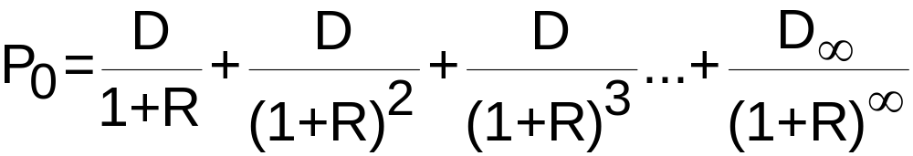
Equity Valuation
Zero Growth Dividend Model
The dividend payment pattern remains constant over time: D₁ = D₂ = D₃ = . . . = D∞
In this case the dividend-discount model (Equation 9.1) becomes:

Slide 39
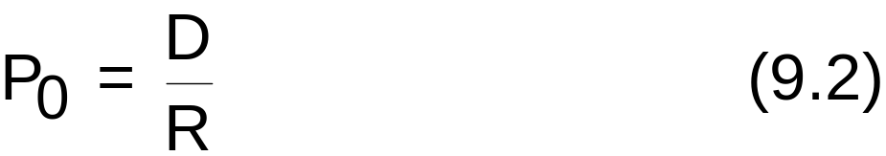
Equity Valuation
Zero Growth Dividend Model
This cash flow pattern essentially describes a perpetuity with a constant cash flow.
In Chapter 6 we developed the present value of a perpetuity with a constant cash flow as CF/i, where CF is the constant cash flow and i is the interest rate.
Similarly, equation 9.2 gives the valuation model for a zero growth stock.

Slide 40
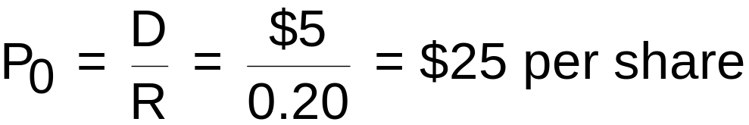
Equity Valuation
Zero Growth Dividend Model Example
Del Mar Corporation pays $5 dividend per year, and the board of directors has no plans to change the dividend. The firm’s investors expect a 20 percent return on investment. What should be the price of the firm’s stock?

Slide 41
Equity Valuation
Constant Growth Dividend Model
Cash dividends do not remain constant but instead grow at some average rate g from one period to next forever.
Constant dividend growth is appropriate assumption for mature companies with history of stable growth.
While an infinite horizon is hard to comprehend, far-distant dividends have small present value and contribute very little to price of stock.

Slide 42
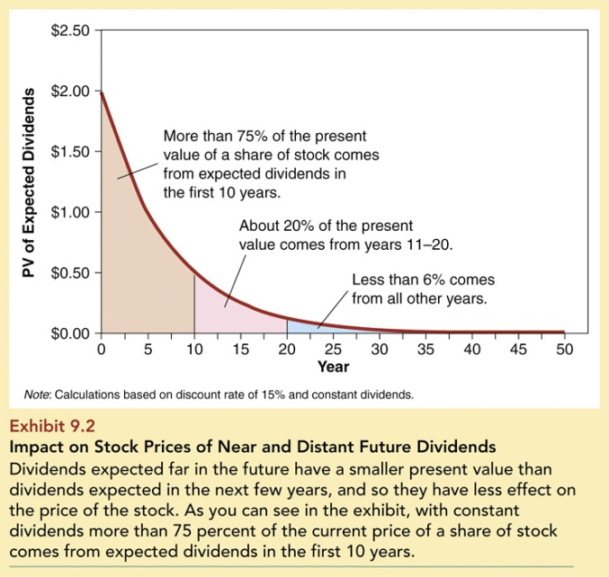
Exhibit 9.2: Impact on Stock Prices

Slide 43
Equity Valuation
Constant-Growth Dividend Model
Deriving the constant-growth dividend model is fairly straightforward.
  We must build a model to compute value of dividend payments for any time period.
The constant-growth dividend model is easy to do because it is just an application of Equation 6.6 from Chapter 6.

Slide 44
Equity Valuation
Constant-Growth Dividend Model
Recall that equation for a growing perpetuity in Chapter 6 is equation 6.6:
PVA∞ = CF₁/(i − g)
The constant-growth dividend model tells us that the current price of a share of stock is the next period dividend divided by the difference between the discount rate and the dividend growth rate.

Slide 45
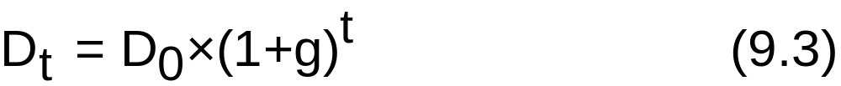
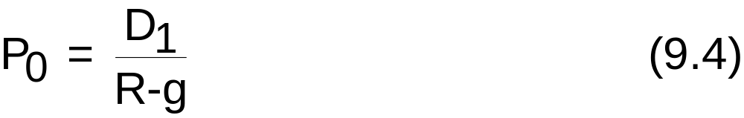
Equity Valuation
Constant-Growth Dividend Model
With the constant-growth dividend model, the general formula for dividend values is as follows:
Equation 9.4 shows how to value a constant-growth stock :

Slide 46
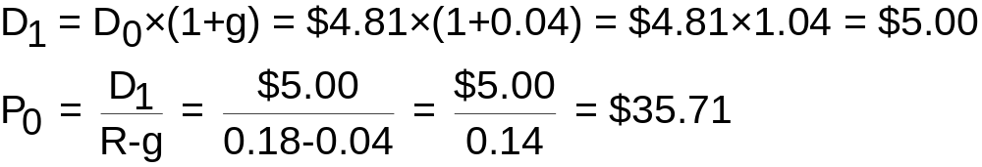
Equity Valuation
Constant-Growth Dividend Model Example
This year’s dividend will be $4.81 for Big Red Automotive. The dividends will grow at a constant 4 percent and investors who own stock in similar types of firms expect to earn a return of 18 percent. What is the value of the firm’s stock?

Slide 47
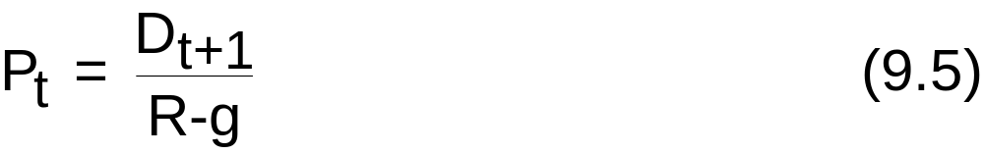
Equity Valuation
Computing Future Stock Prices
The constant-growth dividend model (Equation 9.4) can be generalized to determine value, or price, of share of stock at any point in time.
Equation 9.5 shows price of share of stock at any time t as follows:

Slide 48
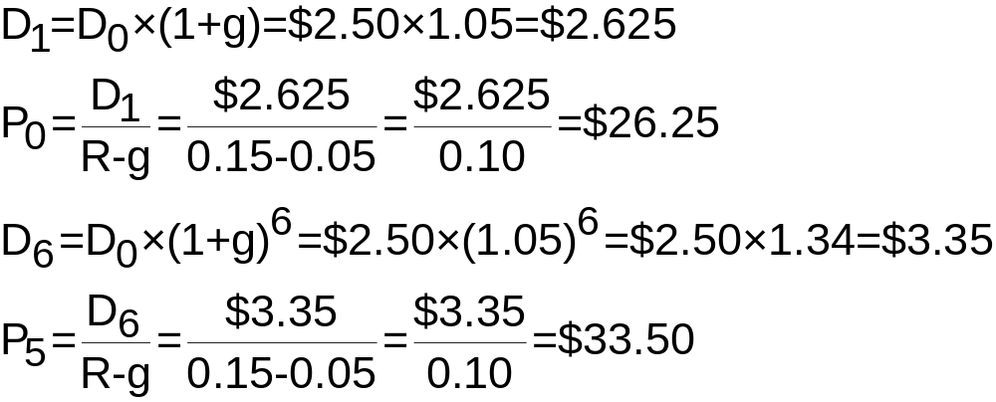
Equity Valuation
Computing Future Stock Prices Example
A firm has a current dividend (D₀) of $2.50, R is 15 percent, and g is 5 percent. What is the price of the stock today (P₀) and what will it be in five years (P₅)?

Slide 49
Equity Valuation
The Relationship between R and g
Constant-growth dividend model yields solutions that are invalid whenever dividend growth rate equals or exceeds discount rate (g ≥ R).
If g = R, the value of the denominator is zero and the value of the stock is infinite–which makes no sense.

Slide 50
Equity Valuation
The Relationship between R and g
If g > R, the present value of the dividend gets bigger and bigger rather than smaller and smaller as it should. This implies that a firm that is growing at a very fast rate does so forever.

Slide 51
Equity Valuation
Supernormal-Growth Dividend Model
During the early part of their lives, very successful firms experience a supernormal rate of growth in earnings.
To value a share of stock for a firm with supernormal dividend growth patterns, we can apply Equation 9.1, our general dividend model, and Equation 9.5, which gives the price of share of stock with constant dividend growth at any point in time.

Slide 52
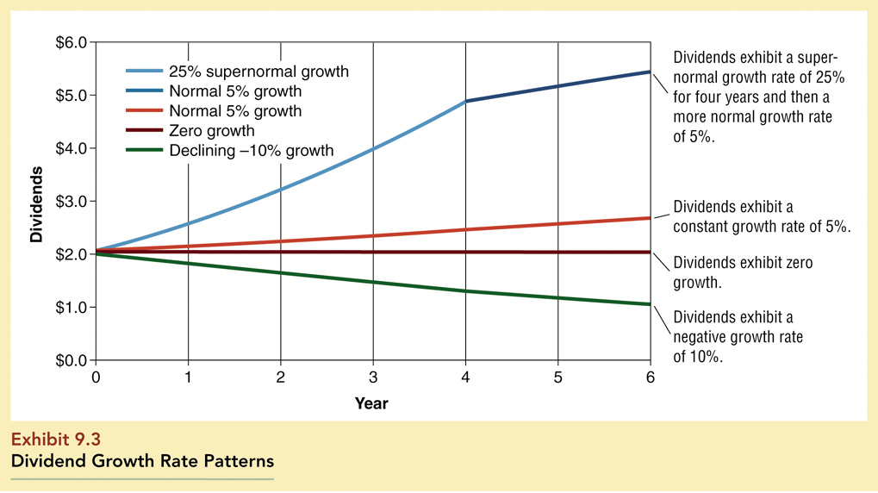
Exhibit 9.3: Dividend Growth Rate Patterns

Slide 53
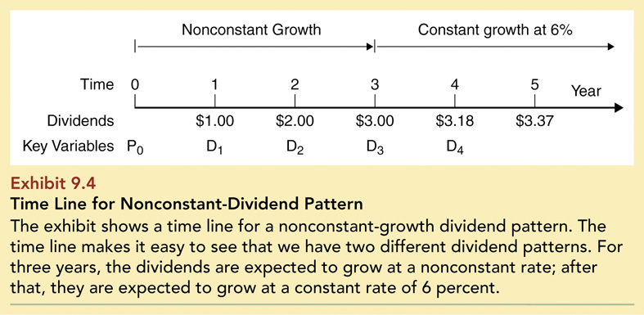
Exhibit 9.4: Timeline for Nonconstant-Dividend Pattern

Slide 54
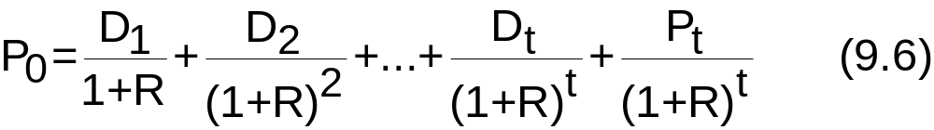
Equity Valuation
Supernormal-Growth Dividend Model
Thus, our valuation model is:
P₀ = PV (Mixed dividend growth) + PV (Constant dividend growth)

Slide 55
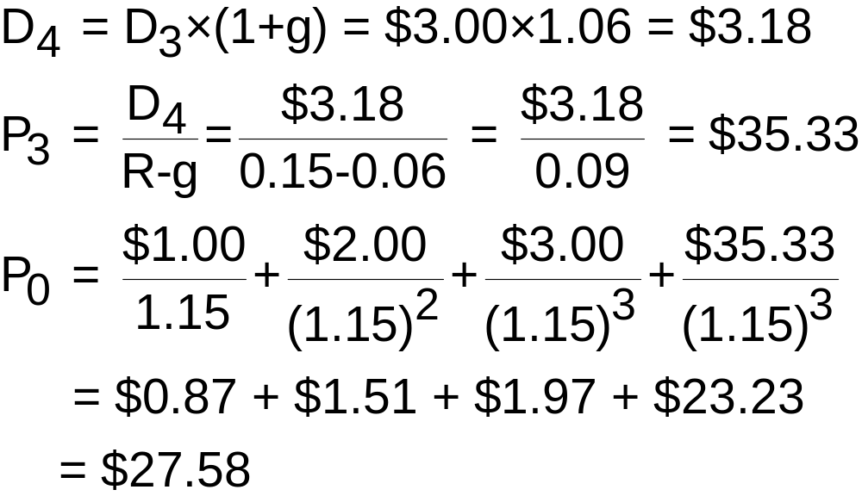
Equity Valuation
Supernormal-Growth Dividend Model Example
Find the value of the stock described in Exhibit 9.4.

Slide 56
Equity Valuation
Valuing Preferred Stock
In computing the value of preferred stock, one must know whether preferred stock has an effective “maturity” because of a sinking-fund option or call option.
Most significant difference between preferred stock with a fixed maturity and a bond is risk of default.

Slide 57
Equity Valuation
Valuing Preferred Stock
Since preferred-stock dividends are declared by the board of directors, failure to pay dividends does not result in default.
Failure to pay a preferred-stock dividend as promised is a serious financial breach and signals to the market that firm is in serious financial difficulty.

Slide 58
Equity Valuation
Preferred Stock with a Fixed Maturity
We can use the bond valuation model developed in Chapter 8 to determine its price, or value.
Equation 8.2 in chapter 8 can be restated as the price of a share of preferred stock (PS₀).

Slide 59
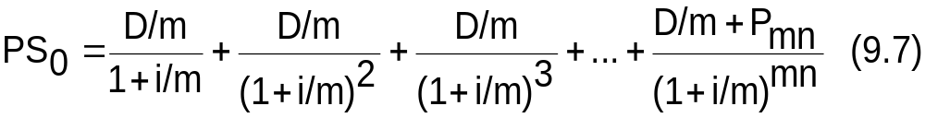
Equity Valuation
Preferred Stock with a Fixed Maturity
Preferred stock price = PV (Dividend payments) + PV (Par value)
Since most preferred stocks make quarterly dividend payments, m equals 4.

Slide 60
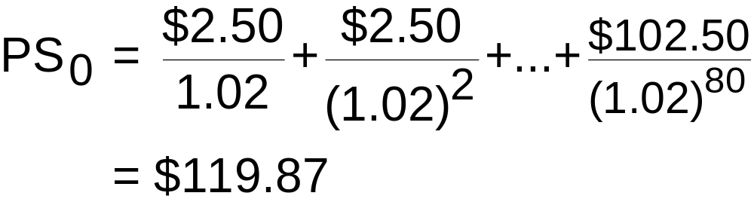
Equity Valuation
Preferred Stock with a Fixed Maturity Example
A utility company’s preferred stock has an annual dividend payment of $10 (paid quarterly), a stated (par) value of $100, and an effective maturity of 20 years. If similar preferred stock issues have market yields of 8 percent, what is the value of the preferred stock?

Slide 61
Equity Valuation
Preferred Stock with a Fixed Maturity Example
The financial calculator solution of this problem is as follows:
Enter
80
2
2.50
1,00
N
i
PV
PMT
FV
Answer
-119.87

Slide 62
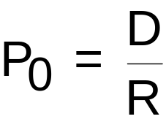
Equity Valuation
Perpetual Preferred Stock
Some preferred-stock issues have no maturity.
Dividends are constant over time (g = 0).
Fixed dividend payments go on forever.
We can use Equation 9.2 to value such preferred-stock issues.

Slide 63
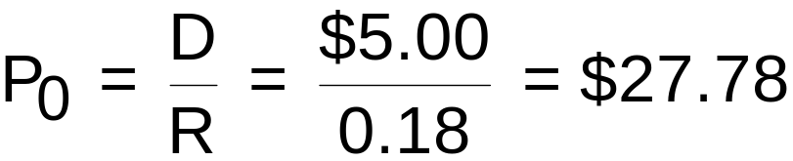
Equity Valuation
Perpetual Preferred Stock Example
Northwest Airlines has a perpetual preferred stock issue that pays a dividend of $5 per year. Investors require an 18 percent return on such an investment. What should be the value of the preferred stock?

